Slide 1
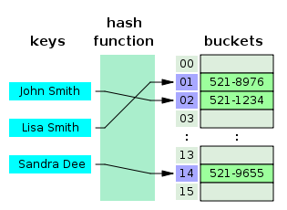
COSC 222 Data Structures
Yves Lucet
CC BY-SA 3.0 https://en.wikipedia.org/wiki/Skip_list#/media/File:Skip_list_add_element-en.gif
"Hash table 3 1 1 0 1 0 0 SP" by Jorge Stolfi - Own work. Licensed under CC BY-SA 3.0 via Commons - https://commons.wikimedia.org/wiki/File:Hash_table_3_1_1_0_1_0_0_SP.svg#/media/File:Hash_table_3_1_1_0_1_0_0_SP.svg

Slide 2

Peer3: There are 219 students registered Due tonight

Slide 3
Notes:
1 Readings is to be done after Class 1 and before Class 2

Slide 4
Plan
tMAT feedback
Summary
Binary search tree
AVL tree
(2,4) tree
Red-Black tree

Slide 5
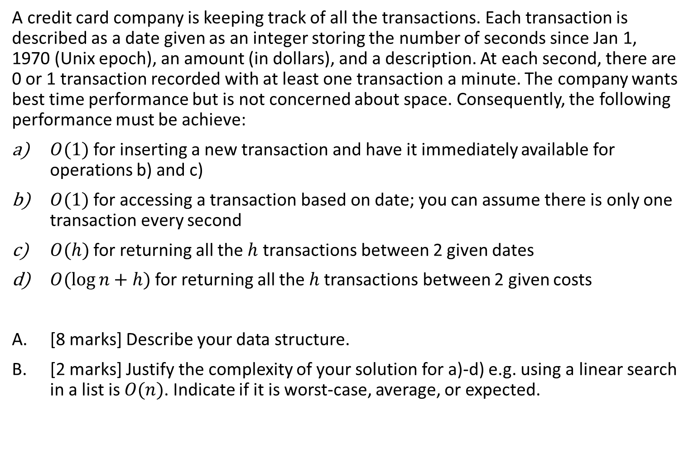
tMAT: build & critic
A credit card company is keeping track of all the transactions. Each transaction is described as a date given as an integer storing the number of seconds since Jan 1, 1970 (Unix epoch), an amount (in dollars), and a description. At each second, there are 0 or 1 transaction recorded with at least one transaction a minute. The company wants best time performance but is not concerned about space. Consequently, the following performance must be achieve:
$O(1)$ for inserting a new transaction and have it immediately available for operations b) and c)
$O(1)$ for accessing a transaction based on date; you can assume there is only one transaction every second
$O(h)$ for returning all the $h$ transactions between 2 given dates
$O(\log{n+h)}$ for returning all the $h$transactions between 2 given costs
[8 marks] Describe your data structure.
[2 marks] Justify the complexity of your solution for a)-d) e.g. using a linear search in a list is $O(n)$. Indicate if it is worst-case, average, or expected.

Slide 6
tMAT: Solution 1 array + list + skip list
Array indexed on date storing pointer to transaction and to transaction position in list
max array size in Java is 2^31/4 = 17 years
singled linked list<Transaction>; essentially each Transaction has a next pointer to the next transaction
skip list with key = cost
Insert transaction in list in order they arrive i.e. sorted by time, in array with pointer to list node, and in skip list with pointer to list node
a) O(1); b) O(1); c) find start & end in Array then iterate in the list: O(h) since there is at least one transaction per minute d) skip list O(log n + h)
Notes:
The assumption that there is at least one transaction per minute is necessary otherwise query for an empty range will take time proportional to the size of the range, which may be greater than O(h). With one transaction per minute we know iterating in the array 60 times at most will find at least one transaction, then we iterate from that position in the linked list.
A side effect of that assumption is if we do not use a list, next pointer, or nextIndex integer and just iterate on the array even through lots of empty cells, the complexity is still O(h) since over 60 cells there is at least 1 transaction and at most 60 i.e. the worst case is 1 transaction for 59 empty cells i.e. less than 60h, which is still O(h).

Slide 7
tMAT: Solution 1’ array + nextIndex + skip list
Array indexed on date storing pointer to transaction + skip counter
skip counter i.e. the index of the next transaction, which plays the same role as a pointer to the next transaction
skip list with key = cost
Insert transaction in array with pointer to list node, and in skip list with pointer to list node; update skip counter and update previous transaction skip counter
a) O(1); b) O(1); c) find start Array, iterate in Array using skip counter: O(h); d) skip list O(log n + h)
Cannot use skip counter to replace skip list. Why?
Notes:
the skip counter is simulating a linked list i.e. every transaction is storing the time of the next transaction
array index is date while skip list key is cost
Cannot use skip counter to replace skip list. Why? Since skip counter is on time while skip list is sorted by cost

Slide 8
tMAT: Solution 2 [Most logical] hash table + pointer + skip list
2022-10-27
Hash function
hash table with key on date [saves space]
Each transaction stores a pointer to the next transaction (explicit list data structure)
SkipList with key on cost (in cents)
a) O(1); b) O(1); expected time
c) O(h) worst case after O(1) expected to find first transaction i.e. O(h) expected, O(n) worst-case
d) O(log n + h) expected
Notes:
The hash table advantage is that it reduces the space complexity with minimal impact on the time complexity
The pointer is required otherwise the range query on time runs in O(n) since elements in a hash table are not kept in sorter order

Slide 9
tMAT: Solution 3 [Most time efficient] array + nextTransInt + array
Array with index on (translated) key on date as epoch and transaction storing the next transaction date [waste space]
Transaction object stores date, cost, description, nextTransactionTime
array indexed by cost (in cents) with value storing a list of pointers to Transactions having that specific cost [waste space]
a) O(1); b) O(1); worst-case time
c) O(h) worst-case
d) O(h + range size) worst-case
Notes:
The transaction object is stored once with the date array storing a reference to that transaction and the cost array also storing a reference to the relevant transaction
Both arrays waste space but optimize the time complexity. The nextTransactionTime (aka skip counter) avoid using a list.

Slide 10
tMAT: Solution 4 [Best overall] hash table + nextTransInt + array
2022-10-27
1666912734
Hash table with key on seconds
Transaction object stores date, cost, description, nextTransactionTime
array indexed by cost (in cents) with value storing a list of pointers to Transactions having that specific cost [waste space]
a) O(1); b) O(1); expected time
c) O(h) worst-case
d) O(h + range size) worst-case
Hash function
Notes:
The transaction object is stored once with the date array storing a reference to that transaction and the cost array also storing a reference to the relevant transaction
Both arrays waste space but optimize the time complexity. The nextTransactionTime (aka skip counter) avoid using a list.

Slide 11
tMAT
Average 72%; 2016: 76%; 2014: 74%
Feeback:
no need to write pseudo-code or Java!
Other
Transaction object pre-made or need to be created?
Map is not precise enough: hashmap, treemap…?
Do NOT use a data structure you do not understand, e.g., TreeMap
Binary search tree is NOT a heap
h and n are different: number of transactions between dates vs. total number of transactions. Ask questions
Date did not have to be converted to int (already is)
Do not criticize your own poster!

Slide 12
Readings
Search trees
For Red-Black trees: do not memorize rotations, just be convinced the tree performs as expected
You should be able to
Recognize Binary Search Tree, AVL, Red-Black, 2-3-4 (at https://people.ok.ubc.ca/ylucet/DS/BTree.html use Max. Degree =4) Trees
Given an AVL/2-3-4/Binary Search tree, draw the resulting tree after insert/delete
Know the complexity of each operation
Notes:
11:10

Slide 13

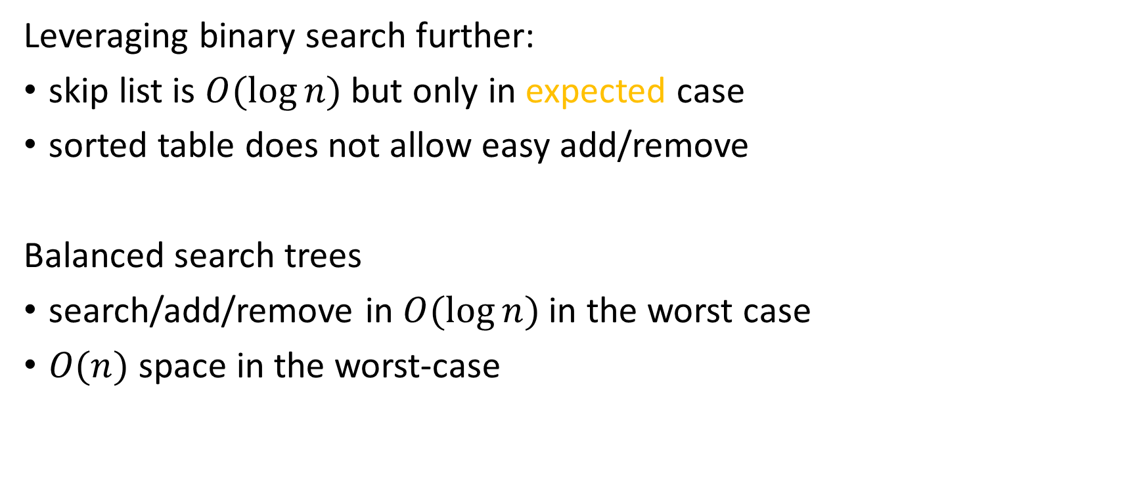
Balanced search trees
Leveraging binary search further:
skip list is $O(\log{n)}$ but only in expected case
sorted table does not allow easy add/remove
Balanced search trees
search/add/remove in $O(\log{n)}$ in the worst case
$O(n)$ space in the worst-case

Slide 14
Binary Search Trees
Presentation for use with the textbook Data Structures and Algorithms in Java, 6th edition, by M. T. Goodrich, R. Tamassia, and M. H. Goldwasser, Wiley, 2014
<
6
2
>
9
1
4
=
8

Slide 15
Binary Search Trees
A binary search tree is a binary tree storing keys (or key-value entries) at its internal nodes and satisfying the following property:
Let u, v, and w be three nodes such that u is in the left subtree of v and w is in the right subtree of v. We have key(u) ≤ key(v) ≤ key(w)
External nodes do not store items
An inorder traversal of a binary search trees visits the keys in increasing order
6
2
9
1
4
8

Slide 16
Search
Algorithm TreeSearch(k, v)
if T.isExternal (v)
return v
if k < key(v)
return TreeSearch(k, left(v))
else if k = key(v)
return v
else { k > key(v) }
return TreeSearch(k, right(v))
To search for a key k, we trace a downward path starting at the root
The next node visited depends on the comparison of k with the key of the current node
If we reach a leaf, the key is not found
Example: get(4):
Call TreeSearch(4,root)
The algorithms for nearest neighbor queries are similar
<
6
2
>
9
1
4
=
8

Slide 17
Insertion
<
6
To perform operation put(k, o), we search for key k (using TreeSearch)
Assume k is not already in the tree, and let w be the leaf reached by the search
We insert k at node w and expand w into an internal node
Example: insert 5
2
>
9
1
4
>
8
w
6
2
9
1
4
8
w
5

Slide 18
Deletion
To perform operation remove(k), we search for key k
Assume key k is in the tree, and let let v be the node storing k
If node v has a leaf child w, we remove v and w from the tree with operation removeExternal(w), which removes w and its parent
Example: remove 4
<
6
2
>
9
1
4
v
8
w
5
6
2
9
1
5
8

Slide 19
Deletion (cont.)
1
v
We consider the case where the key k to be removed is stored at a node v whose children are both internal
we find the internal node w that follows v in an inorder traversal
we copy key(w) into node v
we remove node w and its left child z (which must be a leaf) by means of operation removeExternal(z)
Example: remove 3
3
2
8
6
9
w
5
z
1
v
5
2
8
6
9

Slide 20
Performance
Consider an ordered map with n items implemented by means of a binary search tree of height h
the space used is O(n)
methods get, put and remove take O(h) time
The height h is O(n) in the worst case and O(log n) in the best case

Slide 21


Application
Notes:
11:17

Slide 22
AVL Trees
Presentation for use with the textbook Data Structures and Algorithms in Java, 6th edition, by M. T. Goodrich, R. Tamassia, and M. H. Goldwasser, Wiley, 2014
6
v
3
8
z
4
Notes:
11:22

Slide 23
AVL Tree Definition
Height of node v is number of edges from leaf node to v in the longest path
AVL trees are balanced
An AVL Tree is a binary search tree such that for every internal node v of T, the heights of the children of v can differ by at most 1
An example of an AVL tree where the heights are shown next to the nodes
Notes:
Height of node v is number of edges from leaf node to v in the longest path

Slide 24
Height of an AVL Tree
n(2)
3
4
n(1)
Fact: The height of an AVL tree storing n keys is O(log n).
Proof (by induction): Let us bound n(h): the minimum number of internal nodes of an AVL tree of height h.
We easily see that n(1) = 1 and n(2) = 2
For n > 2, an AVL tree of height h contains the root node, one AVL subtree of height n-1 and another of height n-2.
That is, n(h) = 1 + n(h-1) + n(h-2)
Knowing n(h-1) > n(h-2), we get n(h) > 2n(h-2). So
n(h) > 2n(h-2), n(h) > 4n(h-4), n(h) > 8n(n-6), … (by induction),
n(h) > 2^{i}n(h-2i)
Solving the base case we get: n(h) > 2 ^{h/2-1}
Taking logarithms: h < 2log n(h) +2
Thus the height of an AVL tree is O(log n)

Slide 25
Insertion
Insertion is as in a binary search tree
Always done by expanding an external node.
Example:
44
44
17
78
17
78
c=z
a=y
32
50
88
32
50
88
48
62
48
62
b=x
54
before insertion
w
after insertion

Slide 26
Trinode Restructuring
Let (a,b,c) be the inorder listing of x, y, z
Perform the rotations needed to make b the topmost node of the three
Single rotation around b
Double rotation around c and a
a=z
a=z
b=y
T₀
c=y
T₀
c=x
b=x
T₃
T₁
b=y
b=x
T₂
T₃
T₁
T₂
a=z
c=x
a=z
c=y
T₀
T₁
T₂
T₃
T₀
T₁
T₂
T₃

Slide 27
Insertion Example, continued
unbalanced...
T
4
1
44
2
3
x
17
y
62
z
1
2
2
32
50
78
1
1
1
...balanced
48
54
88
T
2
T
0
T
1
T
3

Slide 28
Restructuring (as Single Rotations)
Single Rotations:

Slide 29
Restructuring (as Double Rotations)
double rotations:

Slide 30
Removal
Removal begins as in a binary search tree, which means the node removed will become an empty external node. Its parent, w, may cause an imbalance.
Example:
44
44
17
62
17
62
32
50
78
50
78
48
54
88
48
54
88
before deletion of 32
after deletion

Slide 31
Rebalancing after a Removal
Let z be the first unbalanced node encountered while travelling up the tree from w. Also, let y be the child of z with the larger height, and let x be the child of y with the larger height
We perform a trinode restructuring to restore balance at z
As this restructuring may upset the balance of another node higher in the tree, we must continue checking for balance until the root of T is reached
62
a=z
44
w
b=y
44
78
17
62
c=x
17
50
88
50
78
48
54
48
54
88

Slide 32
AVL Tree Performance
AVL tree storing n items
The data structure uses O(n) space
A single restructuring takes O(1) time
using a linked-structure binary tree
Searching takes O(log n) time
height of tree is O(log n), no restructures needed
Insertion takes O(log n) time
initial find is O(log n)
restructuring up the tree, maintaining heights is O(log n)
Removal takes O(log n) time
initial find is O(log n)
restructuring up the tree, maintaining heights is O(log n)

Slide 33
Application
Notes:
11:30

Slide 34
(2,4) Trees
Presentation for use with the textbook Data Structures and Algorithms in Java, 6th edition, by M. T. Goodrich, R. Tamassia, and M. H. Goldwasser, Wiley, 2014
9
2 5 7
10 14
Notes:
11:35

Slide 35
Multi-Way Search Tree
A multi-way search tree is an ordered tree such that
Each internal node has at least two children and stores d −1 key-element items (k_{i}, o_{i}), where d is the number of children
For a node with children v₁ v₂ … v_{d} storing keys k₁ k₂ … k_{d−1}
keys in the subtree of v₁ are less than k₁
keys in the subtree of v_{i} are between k_{i−1} and k_{i} (i = 2, …, d − 1)
keys in the subtree of v_{d} are greater than k_{d−1}
The leaves store no items and serve as placeholders
11 24
2 6 8
15
27 32
30

Slide 36
Multi-Way Inorder Traversal
We can extend the notion of inorder traversal from binary trees to multi-way search trees
Namely, we visit item (k_{i}, o_{i}) of node v between the recursive traversals of the subtrees of v rooted at children v_{i} and v_{i} ₊ ₁
An inorder traversal of a multi-way search tree visits the keys in increasing order
11 24
8
12
2 6 8
15
27 32
2
4
6
10
14
18
30
1
3
5
7
9
11
13
16
19
15
17

Slide 37
Multi-Way Searching
Similar to search in a binary search tree
A each internal node with children v₁ v₂ … v_{d} and keys k₁ k₂ … k_{d−1}
k = k_{i} (i = 1, …, d − 1): the search terminates successfully
k < k₁: we continue the search in child v₁
k_{i−1} < k < k_{i} (i = 2, …, d − 1): we continue the search in child v_{i}
k > k_{d−1}: we continue the search in child v_{d}
Reaching an external node terminates the search unsuccessfully
Example: search for 30
11 24
2 6 8
15
27 32
30

Slide 38
(2,4) Trees
A (2,4) tree (also called 2-4 tree or 2-3-4 tree) is a multi-way search with the following properties
Node-Size Property: every internal node has at most four children
Depth Property: all the external nodes have the same depth
Depending on the number of children, an internal node of a (2,4) tree is called a 2-node, 3-node or 4-node
10 15 24
2 8
12
18
27 32

Slide 39
Height of a (2,4) Tree
Theorem: A (2,4) tree storing n items has height O(log n)
Proof:
Let h be the height of a (2,4) tree with n items
Since there are at least 2^{i} items at depth i = 0, … , h − 1 and no items at depth h, we have n ≥ 1 + 2 + 4 + … + 2^{h−1} = 2^{h} − 1
Thus, h ≤ log (n + 1)
Searching in a (2,4) tree with n items takes O(log n) time
depth
items
0
1
1
2
h−1
2^{h−1}
h
0

Slide 40
Insertion
We insert a new item (k, o) at the parent v of the leaf reached by searching for k
We preserve the depth property but
We may cause an overflow (i.e., node v may become a 5-node)
Example: inserting key 30 causes an overflow
10 15 24
v
2 8
12
18
27 32 35
10 15 24
v
2 8
12
18
27 30 32 35

Slide 41
Overflow and Split
We handle an overflow at a 5-node v with a split operation:
let v₁ … v₅ be the children of v and k₁ … k₄ be the keys of v
node v is replaced nodes v' and v"
v' is a 3-node with keys k₁ k₂ and children v₁ v₂ v₃
v" is a 2-node with key k₄ and children v₄ v₅
key k₃ is inserted into the parent u of v (a new root may be created)
The overflow may propagate to the parent node u
u
u
15 24
15 24 32
v
v'
v"
12
18
27 30 32 35
12
18
27 30
35
v₁
v₂
v₃
v₄
v₅
v₁
v₂
v₃
v₄
v₅

Slide 42
Analysis of Insertion
Algorithm put(k, o)
1. We search for key k to locate the insertion node v
2. We add the new entry (k, o) at node v
3. while overflow(v)
if isRoot(v)
create a new empty root above v
v ← split(v)
Let T be a (2,4) tree with n items
Tree T has O(log n) height
Step 1 takes O(log n) time because we visit O(log n) nodes
Step 2 takes O(1) time
Step 3 takes O(log n) time because each split takes O(1) time and we perform O(log n) splits
Thus, an insertion in a (2,4) tree takes O(log n) time

Slide 43
Deletion
We reduce deletion of an entry to the case where the item is at the node with leaf children
Otherwise, we replace the entry with its inorder successor (or, equivalently, with its inorder predecessor) and delete the latter entry
Example: to delete key 24, we replace it with 27 (inorder successor)
10 15 24
2 8
12
18
27 32 35
10 15 27
2 8
12
18
32 35

Slide 44
Underflow and Fusion
Deleting an entry from a node v may cause an underflow, where node v becomes a 1-node with one child and no keys
To handle an underflow at node v with parent u, we consider two cases
Case 1: the adjacent siblings of v are 2-nodes
Fusion operation: we merge v with an adjacent sibling w and move an entry from u to the merged node v'
After a fusion, the underflow may propagate to the parent u
u
u
9 14
9
w
v
v'
2 5 7
10
2 5 7
10 14

Slide 45
Underflow and Transfer
To handle an underflow at node v with parent u, we consider two cases
Case 2: an adjacent sibling w of v is a 3-node or a 4-node
Transfer operation:
1. we move a child of w to v
2. we move an item from u to v
3. we move an item from w to u
After a transfer, no underflow occurs
u
u
4 9
4 8
w
v
w
v
2
6 8
2
6
9

Slide 46
Analysis of Deletion
Let T be a (2,4) tree with n items
Tree T has O(log n) height
In a deletion operation
We visit O(log n) nodes to locate the node from which to delete the entry
We handle an underflow with a series of O(log n) fusions, followed by at most one transfer
Each fusion and transfer takes O(1) time
Thus, deleting an item from a (2,4) tree takes O(log n) time

Slide 47
Comparison of Map Implementations
 | Search | Insert | Delete | Notes
Hash Table | 1 expected | 1 expected | 1 expected | no ordered map methods simple to implement
Skip List | log n high prob. | log n high prob. | log n high prob. | randomized insertion simple to implement
AVL and (2,4) Tree | log n worst-case | log n worst-case | log n worst-case | complex to implement

Slide 48
Application
Notes:
11:45

Slide 49
Red-Black Trees
Presentation for use with the textbook Data Structures and Algorithms in Java, 6th edition, by M. T. Goodrich, R. Tamassia, and M. H. Goldwasser, Wiley, 2014
6
v
3
8
z
4
Notes:
11:50

Slide 50
From (2,4) to Red-Black Trees
A red-black tree is a representation of a (2,4) tree by means of a binary tree whose nodes are colored red or black
In comparison with its associated (2,4) tree, a red-black tree has
same logarithmic time performance
simpler implementation with a single node type
4
3 5
2 6 7
4
5
3
6
OR
3
5
2
7

Slide 51
Red-Black Trees
A red-black tree can also be defined as a binary search tree that satisfies the following properties:
Root Property: the root is black
External Property: every leaf is black
Internal Property: the children of a red node are black
Depth Property: all the leaves have the same black depth
9
4
15
2
6
12
21
7

Slide 52
Height of a Red-Black Tree
Theorem: A red-black tree storing n items has height O(log n)
Proof:
The height of a red-black tree is at most twice the height of its associated (2,4) tree, which is O(log n)
The search algorithm for a binary search tree is the same as that for a binary search tree
By the above theorem, searching in a red-black tree takes O(log n) time

Slide 53
Insertion
To insert (k, o), we execute the insertion algorithm for binary search trees and color red the newly inserted node z unless it is the root
We preserve the root, external, and depth properties
If the parent v of z is black, we also preserve the internal property and we are done
Else (v is red ) we have a double red (i.e., a violation of the internal property), which requires a reorganization of the tree
Example where the insertion of 4 causes a double red:
6
6
v
v
3
8
3
8
z
z
4

Slide 54
Remedying a Double Red
Consider a double red with child z and parent v, and let w be the sibling of v
Case 1: w is black
The double red is an incorrect replacement of a 4-node
Restructuring: we change the 4-node replacement
Case 2: w is red
The double red corresponds to an overflow
Recoloring: we perform the equivalent of a split
w
4
v
w
4
v
2
z
7
2
z
7
6
6
4 6 7
2 4 6 7
.. 2 ..

Slide 55
Restructuring
A restructuring remedies a child-parent double red when the parent red node has a black sibling
It is equivalent to restoring the correct replacement of a 4-node
The internal property is restored and the other properties are preserved
z
4
6
w
v
v
2
7
4
7
z
w
6
2
4 6 7
4 6 7
.. 2 ..
.. 2 ..

Slide 56
Restructuring (cont.)
There are four restructuring configurations depending on whether the double red nodes are left or right children
2
6
6
2
6
2
4
4
4
4
2
6
4
2
6

Slide 57
Recoloring
A recoloring remedies a child-parent double red when the parent red node has a red sibling
The parent v and its sibling w become black and the grandparent u becomes red, unless it is the root
It is equivalent to performing a split on a 5-node
The double red violation may propagate to the grandparent u
w
4
v
w
4
v
2
z
7
2
z
7
6
6
… 4 …
2 4 6 7
2
6 7

Slide 58
Analysis of Insertion
Algorithm insert(k, o)
1. We search for key k to locate the insertion node z
2. We add the new entry (k, o) at node z and color z red
3. while doubleRed(z)
if isBlack(sibling(parent(z)))
z ← restructure(z)
return
else { sibling(parent(z) is red }
z ← recolor(z)
Recall that a red-black tree has O(log n) height
Step 1 takes O(log n) time because we visit O(log n) nodes
Step 2 takes O(1) time
Step 3 takes O(log n) time because we perform
O(log n) recolorings, each taking O(1) time, and
at most one restructuring taking O(1) time
Thus, an insertion in a red-black tree takes O(log n) time

Slide 59
Deletion
To perform operation remove(k), we first execute the deletion algorithm for binary search trees
Let v be the internal node removed, w the external node removed, and r the sibling of w
If either v of r was red, we color r black and we are done
Else (v and r were both black) we color r double black, which is a violation of the internal property requiring a reorganization of the tree
Example where the deletion of 8 causes a double black:
6
6
v
r
3
8
3
r
w
4
4

Slide 60
Remedying a Double Black
The algorithm for remedying a double black node w with sibling y considers three cases
Case 1: y is black and has a red child
We perform a restructuring, equivalent to a transfer , and we are done
Case 2: y is black and its children are both black
We perform a recoloring, equivalent to a fusion, which may propagate up the double black violation
Case 3: y is red
We perform an adjustment, equivalent to choosing a different representation of a 3-node, after which either Case 1 or Case 2 applies
Deletion in a red-black tree takes O(log n) time

Slide 61
Red-Black Tree Reorganization
Insertion | remedy double red
Red-black tree action | (2,4) tree action | result
restructuring | change of 4-node representation | double red removed
recoloring | split | double red removed or propagated up
Deletion | remedy double black
Red-black tree action | (2,4) tree action | result
restructuring | transfer | double black removed
recoloring | fusion | double black removed or propagated up
adjustment | change of 3-node representation | restructuring or recoloring follows

Slide 62
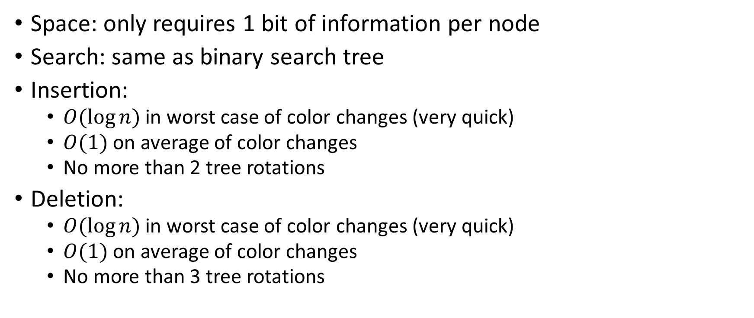
Red-Black tree advantages
Space: only requires 1 bit of information per node
Search: same as binary search tree
Insertion:
$O(\log{n})$ in worst case of color changes (very quick)
$O(1)$ on average of color changes
No more than 2 tree rotations
Deletion:
$O(\log{n})$ in worst case of color changes (very quick)
$O(1)$ on average of color changes
No more than 3 tree rotations
Source: https://en.wikipedia.org/wiki/Red%E2%80%93black_tree

Slide 63
Application
Notes:
12:00

Slide 64
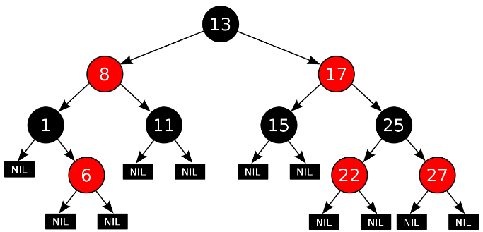
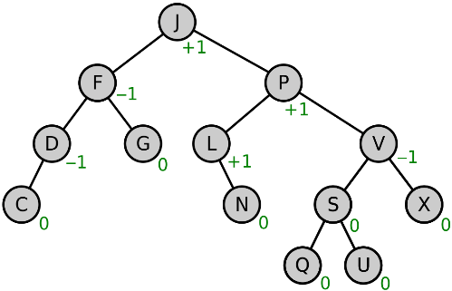

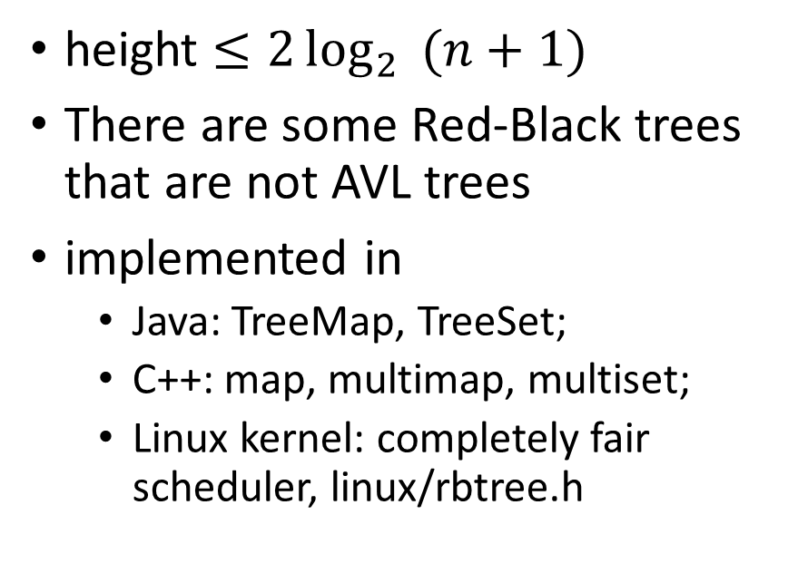
AVL vs. Red-Black tree
AVL
By Cburnett - Own work, CC BY-SA 3.0, https://commons.wikimedia.org/w/index.php?curid=1508398
Red-Black
height $≤1.44\log_{2}\left(n+2\right)+b$
more rigidly balanced
any AVL tree can be colored Red-Black
height $≤2\log_{2}{ (n+1)}$
There are some Red-Black trees that are not AVL trees
implemented in
Java: TreeMap, TreeSet;
C++: map, multimap, multiset;
Linux kernel: completely fair scheduler, linux/rbtree.h
By Nomen4Omen - Own workThis W3C-unspecified vector image was created with Inkscape., CC BY-SA 4.0, https://commons.wikimedia.org/w/index.php?curid=49182185
https://en.wikipedia.org/wiki/AVL_tree#Comparison_to_other_structures
Notes:
12:05

Slide 65
Other trees
B-tree (critical in databases)
Splay tree (reorganize after each search)
Hash tree or Merkle tree (used in block chain)
k-d tree: range queries in k-dimensional space
BK-tree (used in spell-checker)
…

Slide 66
Readings
Date | Files
Sep 13 | 1 readings-Java-UnitTesting.txt 1 readings-Java-UnitTesting.txt
Sep 15 | 2 readings-complexity.txt
Sep 20 | 3 readings-Array-List.txt
Sep 27 | 5_6 readings-recursion-stack-queue.txt
Oct 4 | 7 readings-iterator.txt
Oct 11 | 8_9 readings Trees-PQ.txt
Oct 13 | 10 reading hash skiplist.txt
Oct 18 | 11 readings Dijkstra.txt
Oct 20 | 12 reading union-find.txt
Oct 27 | 14 readings search trees.txt
Nov 17 | 15 reading (2,4)-B trees.txt
The readings should be done before the indicated date with questions posted on Ms Teams.

